Slide 1

IN 1900 (ICT Project)
AUTOMATIC BOXING TRAINING MACHINE
Group No : 40

Slide 2





Group Members
 | Name | Reg.No. | Photo
Group Leader | Siriwardena P.T.Y. | 204203K
Member 1 | Gamage T.T.P.D. | 204059X
Member 2 | Kavishka T.A. | 204101V
Member 3 | Nuska M.F.F. | 204145H
Member 4 | Ekanayaka Y.M | 204239B

Slide 3
Problem in brief
In sports involving only two players, there is a barrier for them to practice on their own. Boxing is that kind of a sport. Always player can’t have a coach, because of having a coach is very expensive and coach can’t hang with us always. When the player is practicing with a coach he has to limit only to coach’s knowledge. Training alone is not successful and also, it’s essential to train with the right techniques to produce a good player.

Slide 4

Brief Introduction on Boxing
What is Boxing?
Boxing is a combat sport in which two competitors try to hit each other with their glove-encased fists while trying to avoid each other’s punches.
What is a Punch?
A punch is a striking blow with the fist.

Slide 5




There are four main punches in boxing
Jab — a quick, straight punch thrown with the lead hand
Cross — a powerful straight punch thrown with the rear hand
Hook — a semi-circular punch thrown with the lead hand to the side of the opponent's head
Uppercut — a vertical, rising punch thrown with the rear hand
the boxer should join them together in proper order to build combinations.

Slide 6


Basic Boxing Moves
Slip
The slip is an effective defensive head movement intended to get you out of the path of an oncoming straight punch from your opponent. Slipping can cause your opponent to miss their punch while, in turn, putting your body in balance for a counter punch.
Roll
The roll is another effective defensive movement used to avoid your opponent's hooks by bending your knees and shifting the weight from the lead side to the backside, and vice versa (rolling in vs. rolling out).

Slide 7
What is a Boxing Combo (Combination)?
A boxing combo is a sequence of punches and movements that player execute to attack their opponent.
Why Need Combinations?
It doesn’t make sense to throw a single punch because opponent boxing player cannot stop by using a single punch. So, boxers always use punch combinations to hit the opponent.

Slide 8
What is the Importance of Practicing Combinations?
Boxers don’t have much more time think about the punches while in the game.
How They Practice Boxing?
Player should have clear understanding about the combinations (steps of the combination) and he can practice those combinations with the help a coach and it will help the player to develop his muscle memory.
https://www.youtube.com/watch?v=6VBIuqjLBNU
https://www.youtube.com/watch?v=mKXLTchmay0
We are going to make a machine to do this practicing procedure without this coach.

Slide 9

How to Make/Build Combinations?
Players have freedom to build their fighting combinations in the opinion of their own.
Recommended by the expert players
What is the Novelty?
While many fighters train with a punching bag, it's not really a fair fight – after all, the bag can't punch back. But this machine can do that.

Slide 10
Project Aim & Objectives
Aim:
Design and develop an automated machine to practice boxing without a coach.
Objectives:
To guide the player to punch the correct positions.
To improve player's muscle memory
To practice alone without an opponent player or a trainer.
To practice a particular punch.
To practice more fighting techniques.
To improve the safety of the beginners.

Slide 11
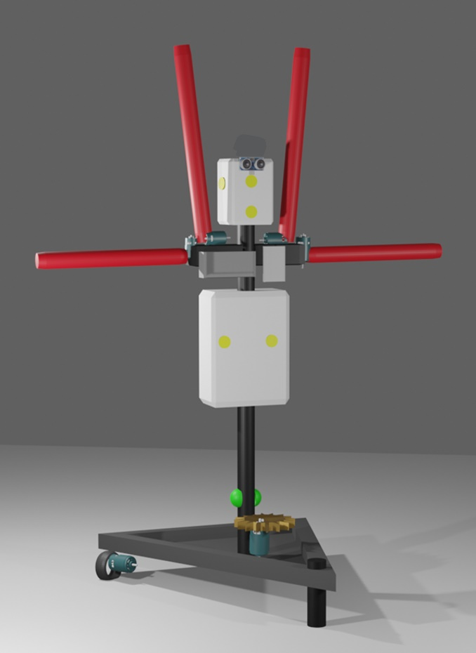
Proposed Solution (3D Model)
Head
Arms
Servo motors
Ultrasonic sensor
LCD Display
LED lights and Piezo sensor
Body
Keypad
PIR sensors
Metal Frame
DC motors
and wheels
Stepper motor

Slide 12
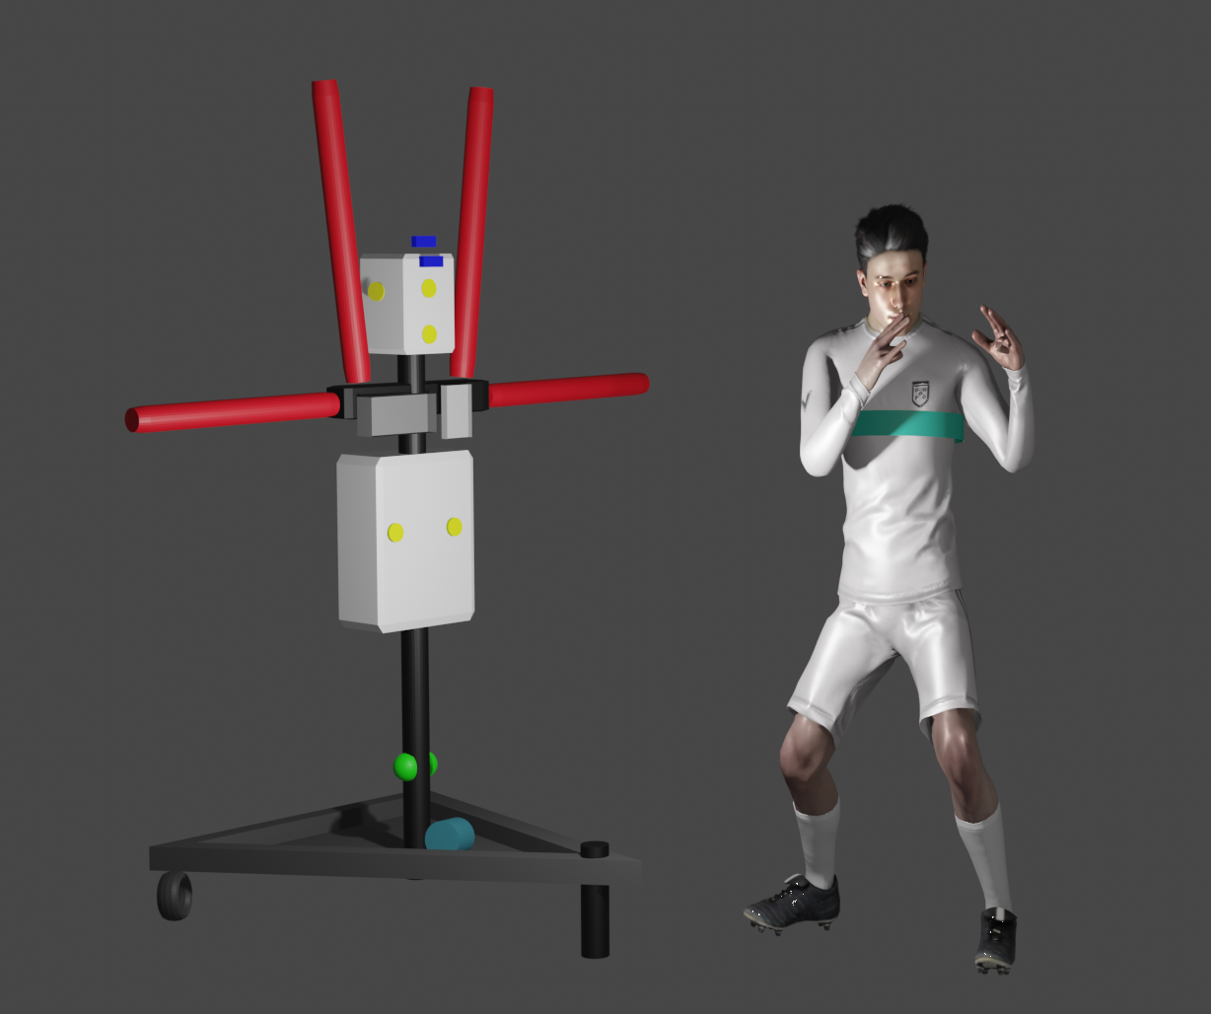
3D Animation :-https://drive.google.com/file/d/12pWCA-nztkhnYb5SVaMTakm1cSb0yxxD/view?usp=sharing
Fitness band with heartbeat sensor

Slide 13
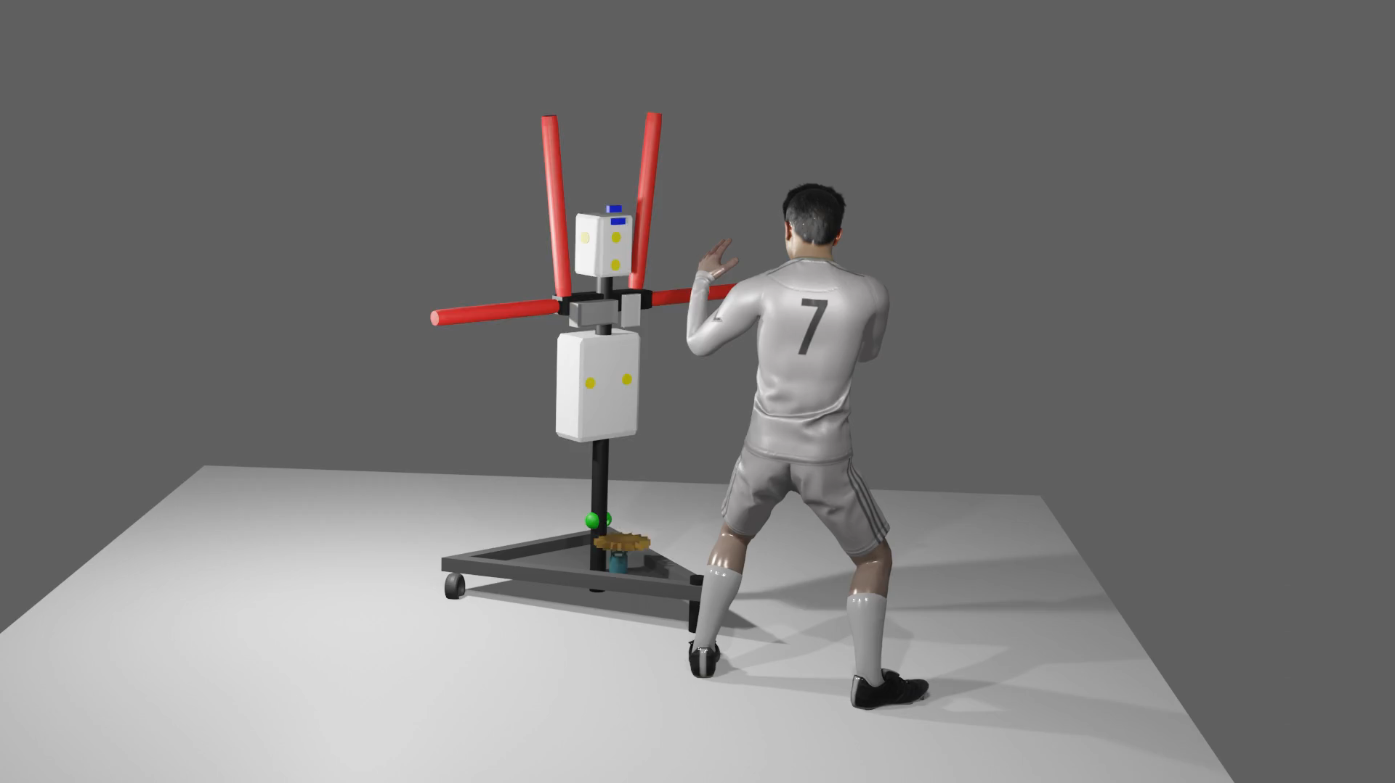

Slide 14
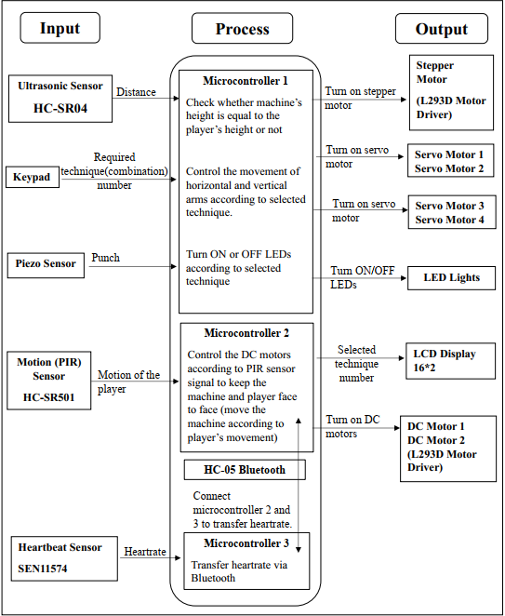
Proposed Solution-System Diagram

Slide 15
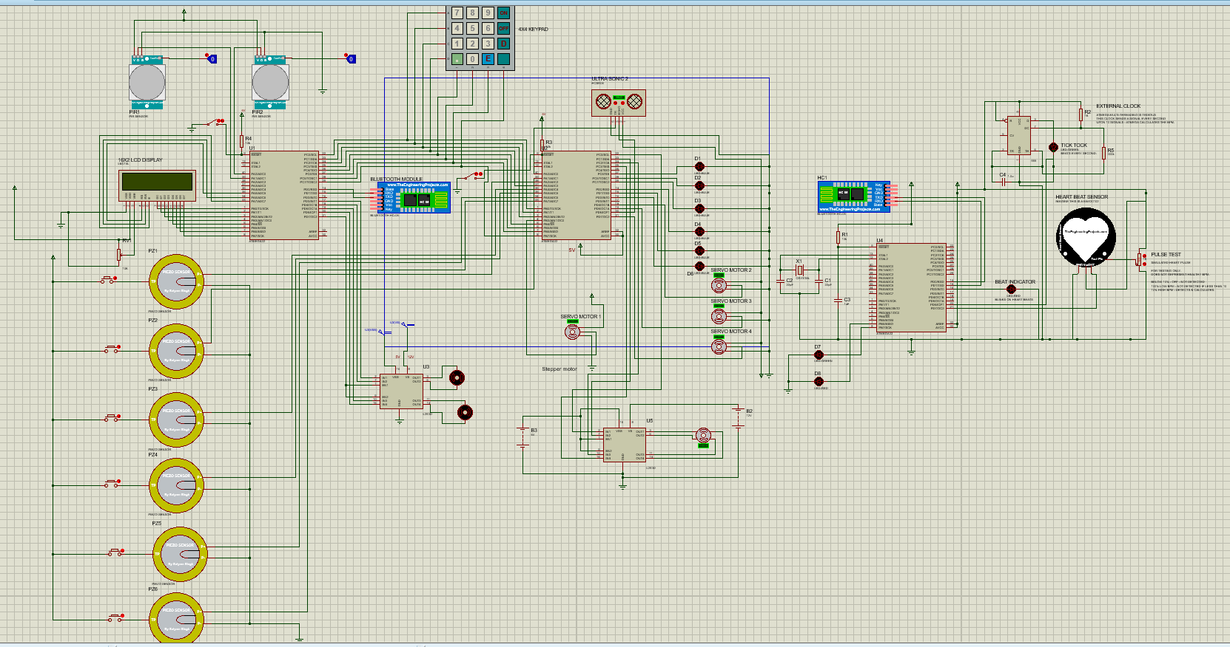
Schematic Diagram

Slide 16
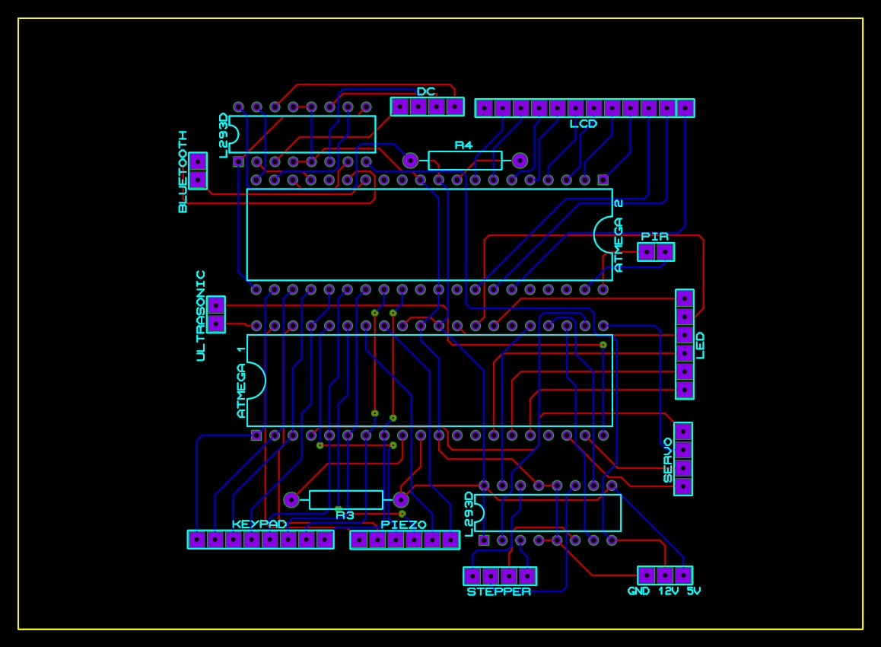
PCB Design
PCB design for machine side

Slide 17
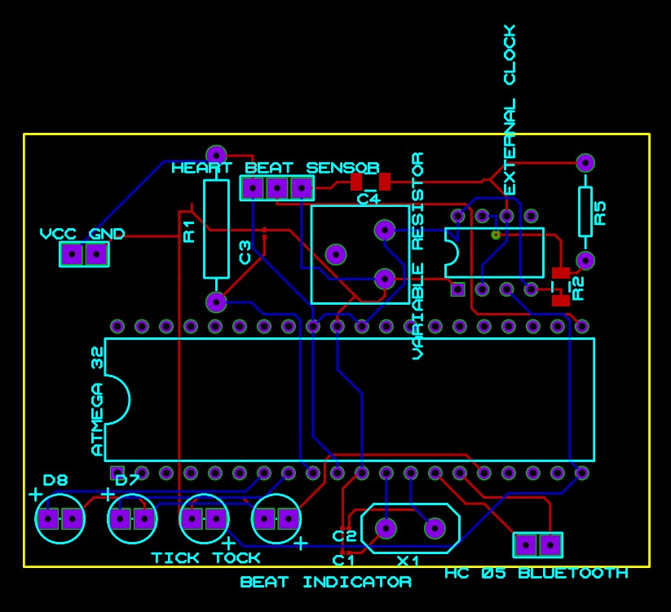
PCB design for Fitness Band

Slide 18
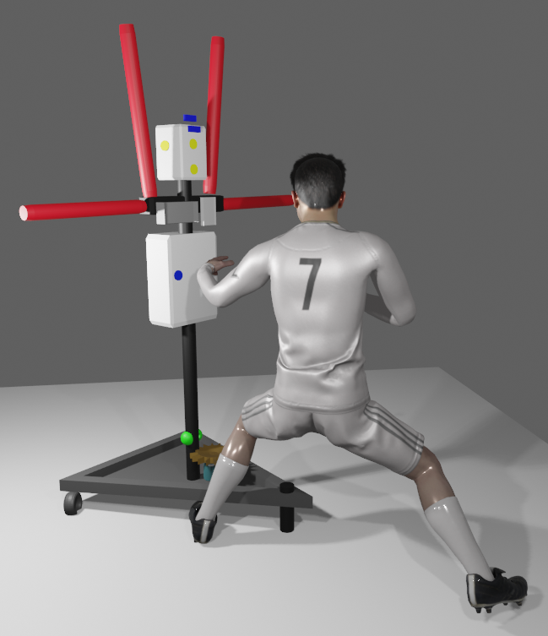
Boxing Fighting Techniques(Combinations)
Combination 1
Step 1 – Jab (Punch by lead arm)
Step 2 – Cross (Punch by back arm)
Step 3 – Slip to Right (Move body to right)
Step 4 – Roll to Right (Walk to right)
Step 1- Jab

Slide 19
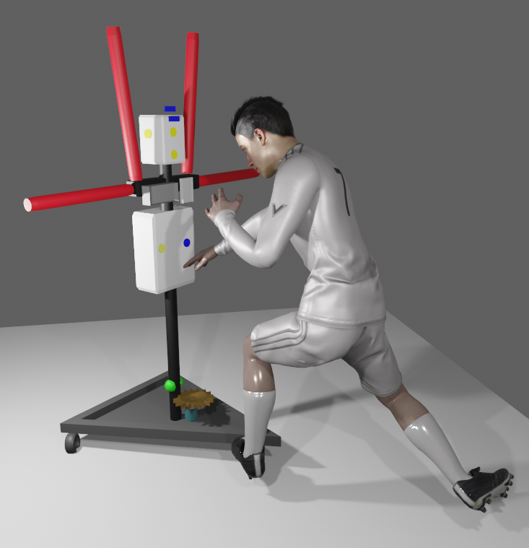
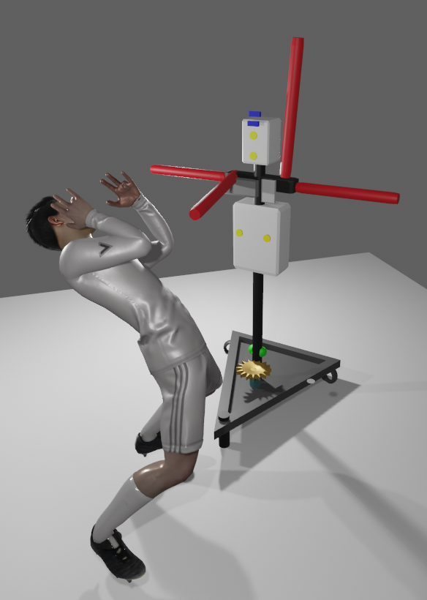
Step 2- Cross
Step 3- Slip to Right

Slide 20
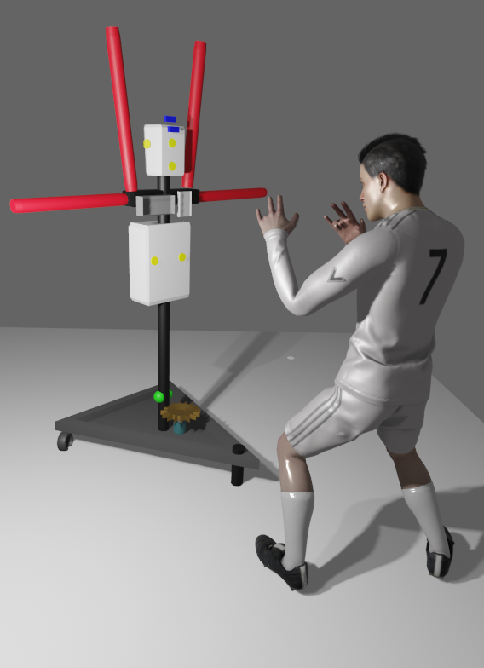
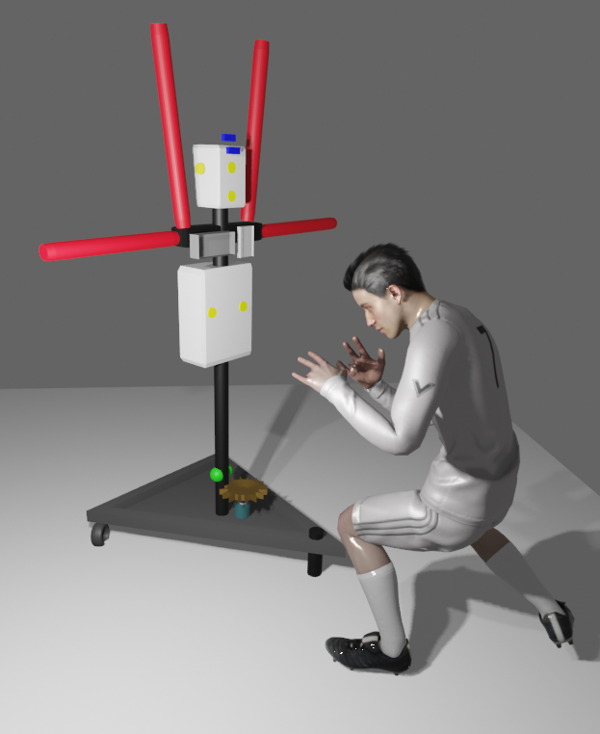
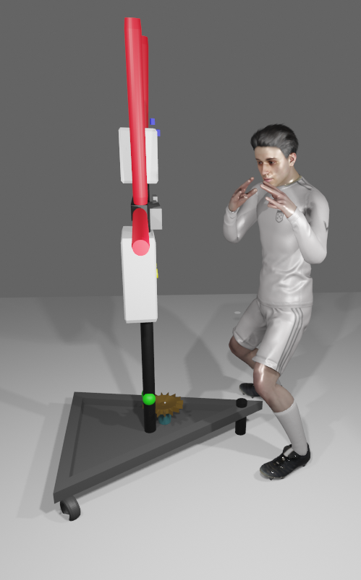
Step 4- Roll to Right

Slide 21
Combinations (Continue..)
Combination 2
Jab
Cross
Slip to left
Left hook-Head (Punch to left side of head)
Cross
Right block (Block right horizontal arm from player’s right hand)
Left hook- Head

Slide 22
Step 1-Jab
Step 2-Cross
Step 3-Slip to left

Slide 23
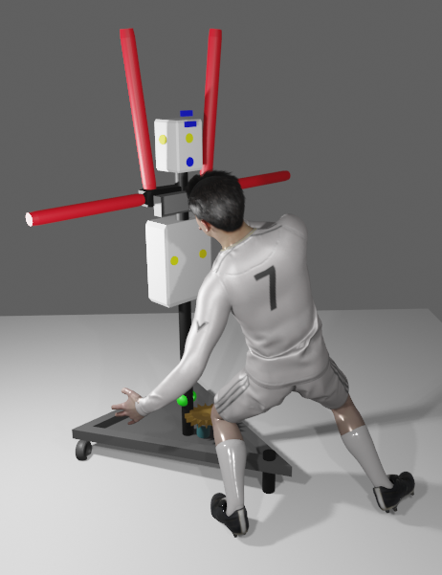
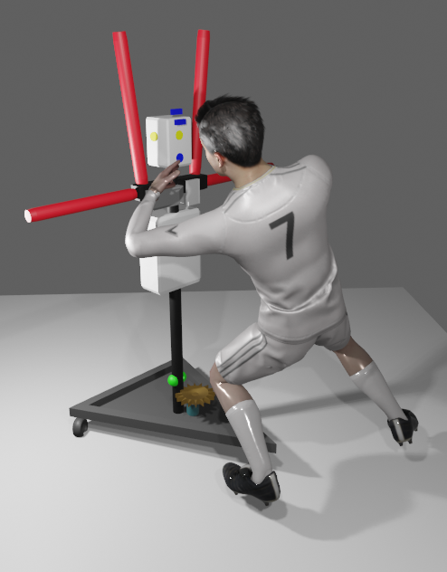
Step 4-Left hook-Head
Step 5-Cross

Slide 24
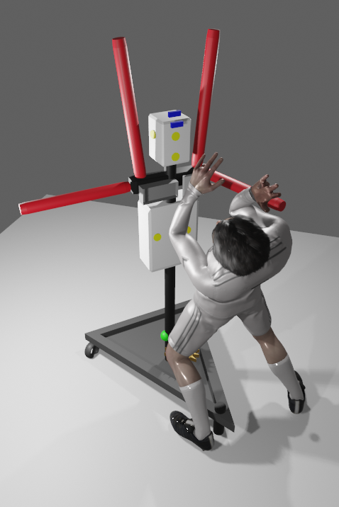
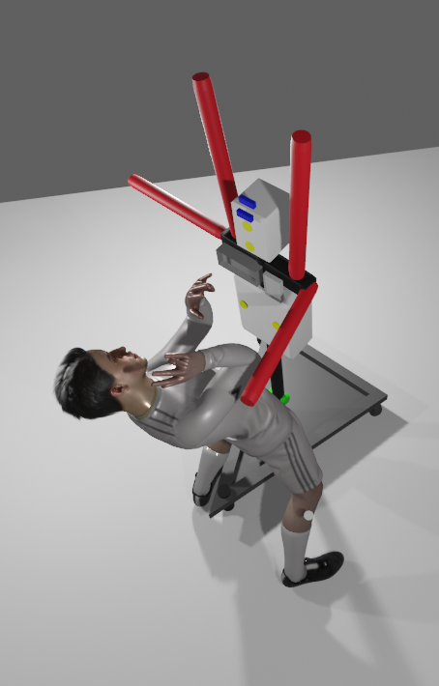
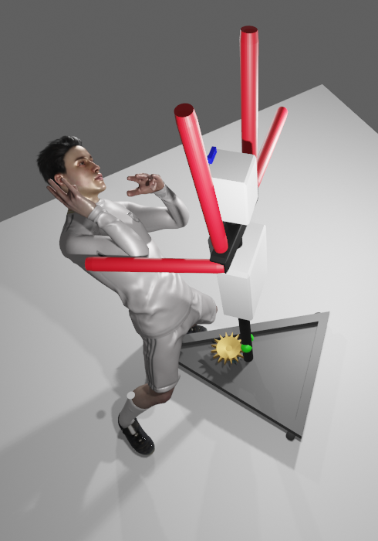
Step 6- Right block
Step 7-Left hook- Head

Slide 25
Combination 3
Right upper cut (Punch to opponent player’s chin by right hand)
Left hook-Head
Cross
Block right
Slip to left
Left hook- Body
Left hook- Head
Cross
Slip to right

Slide 26
Resource Required
Software: Atmel Studio, Blender, Proteus,
Hardware:
Sensors: Motion sensor, Piezo Sensor, Ultrasonic Sensor,Heartbeat Sensor
Microcontroller: Atmega32
Bluetooth Module
Motors: Stepper Motors, Servo Motors, Dc Motors
LCD display
Keypad
LED lights
Power supply unit
Rubber tyre wheels

Slide 27
Cost Estimation
Name | Unit Price (Rs) | Quantity | Amount
At mega 32 microcontroller | 660.00 | 3 | 1980.00
Servo Motor | 600.00 | 5 | 3000.00
Motion Sensor | 250.00 | 2 | 500.00
Piezo Sensor | 25.00 | 6 | 150.00
LED light | 30.00 | 5 | 150.00
Keypad & key | 200.00 | 1 | 200.00
Ultrasonic Sensor | 370.00 | 2 | 740.00
Heartbeat Sensor | 650.00 | 1 | 650.00
Stepper Motor | 1800.00 | 1 | 1800.00
DC Gear Motor | 700.00 | 2 | 1400.00
LCD display | 550.00 | 1 | 550.00
Rexene | 510.00 | 2 meters | 1020.00
Sponge sheet | 600.00 | 2 | 1200.00
Box bar | 100.00 | 12 feet | 1200.00
Rubber tire wheels | 60.00 | 2 | 120.00
L293D DC motor driver | 490.00 | 2 | 980.00
ULN2003 Stepper Motor driver | 200.00 | 1 | 200.00
HC-05 Bluetooth Module | 1000.00 | 2 | 2000.00
Others |  |  | 2000.00
Total |  |  | 19840.00

Slide 28
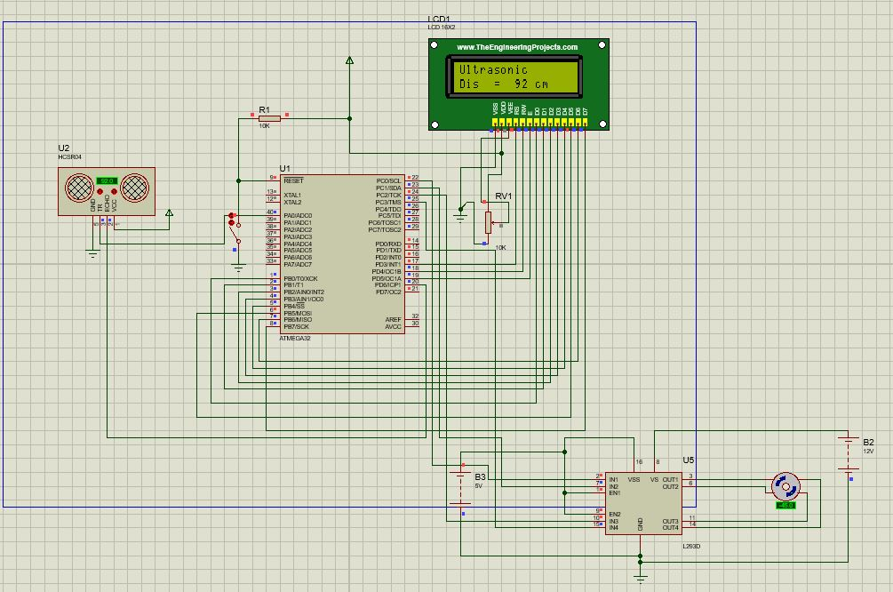
Testing and implementation
First ultrasonic sensor will measure the distance between player and the machine. Then stepper motor will adjust the machine according to the players height.

Slide 29
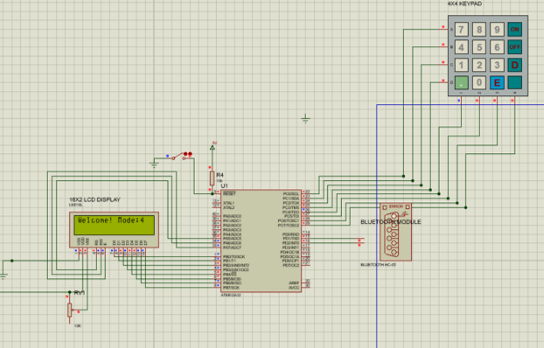
Player can enter the technique number which he is willing to practice. Then the machine will work according to user entered technique (combination). Servo motor will move the arms of the machine according to user entered technique.

Slide 30
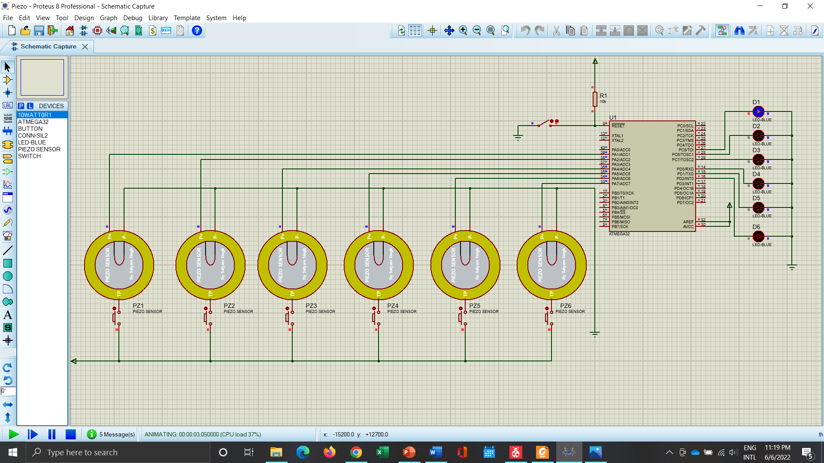
Led lights used to indicate the punching positions. Piezo sensor will detect the punch and according to that LED will get off and next punching position will be indicated

Slide 31
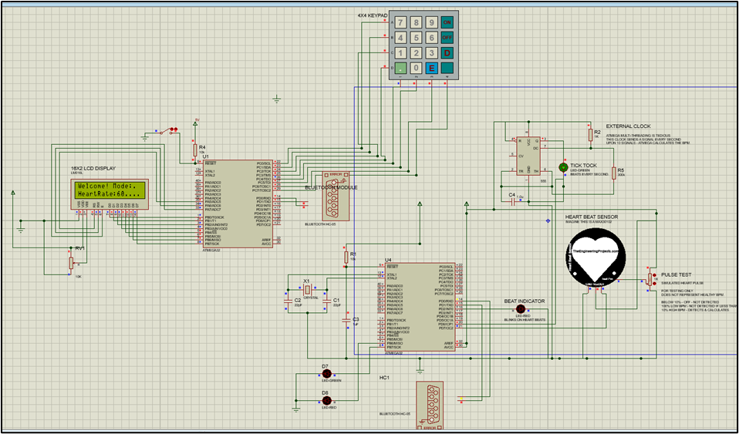
If the player wears the fitness band, then the sensor will measure the heart rate of the player and it will be displayed in the lcd display via Bluetooth.

Slide 32
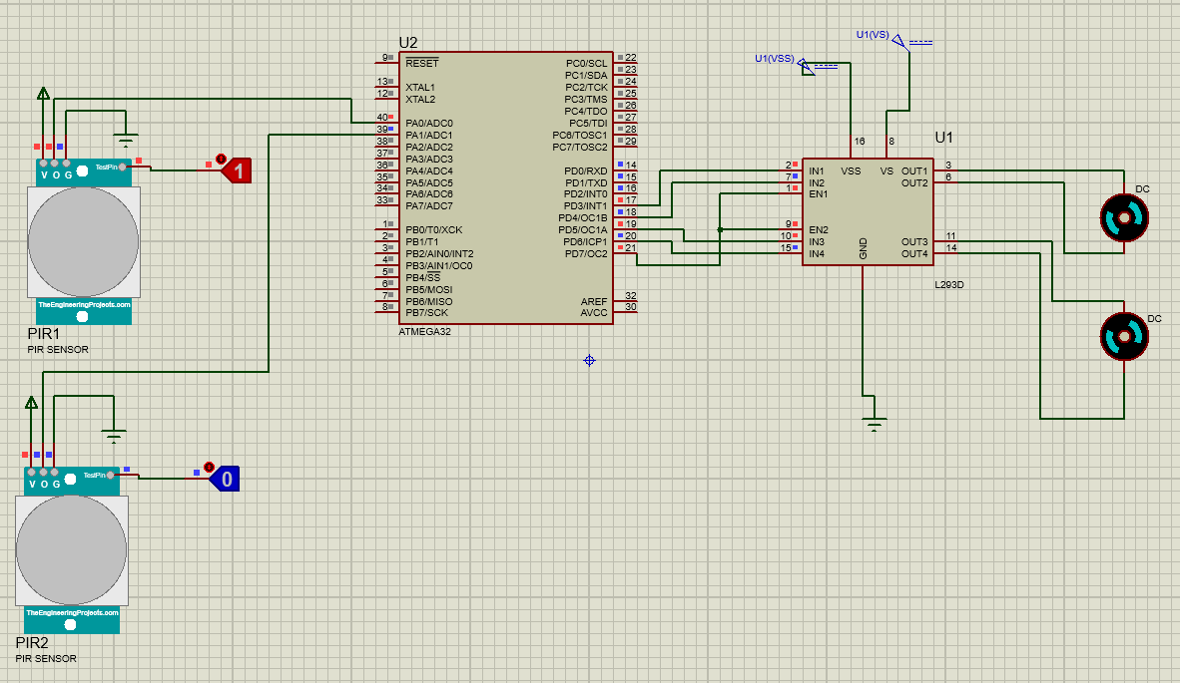
When first PIR sensor detects a motion, dc motors start to rotate clockwise. When second PIR sensor detects a motion, dc motors start to rotate anticlockwise.

Slide 33
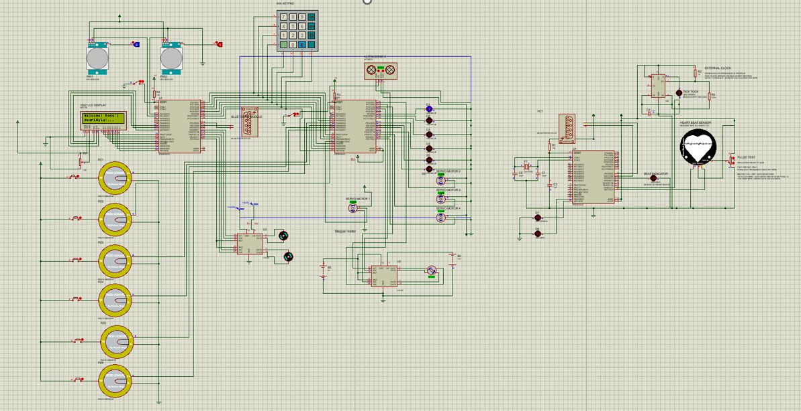
We developed the Full circuit using Proteus and Microchip Studio

Slide 34
Individual Contribution

Slide 35
Member 1 - Gamage T.T.P.D (204059X)
Responsibilities-
Piezo sensor and programming.
LCD Display and programming.
Design power supply unit.

Slide 36
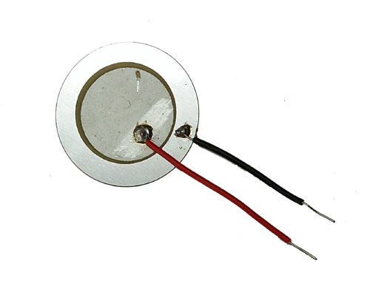
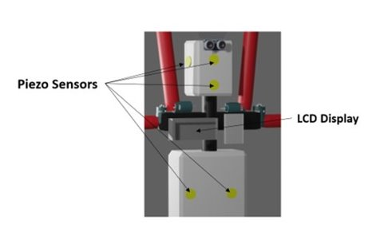
Piezo Sensor
Negative pin
Positive pin
Six piezo sensors use to detect the punch of the boxing player.
Identify the punch that the player made, by voltage produced in sensor.
Then the machine guides the player to punch the most suitable position for the next attack by lighting LED bulbs in sequence according to each technique.

Slide 37
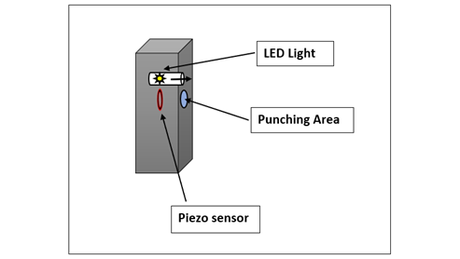
LED lights and Piezo sensors
LED lights are used to guide the player. Led lights are placed in an unbreakable glass cover to protect them from players’ punch. If not, the lights can get broken. These lights indicate the place that the player wanted to punch. If the player punches to the place which the light indicates then the piezo detect the punch and the LED turns off. Then the next LED will turn on where the player wanted to punch next. Likewise, lights turn on in order according to the combination that the player selects.

Slide 38
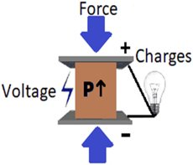
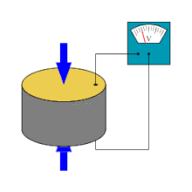
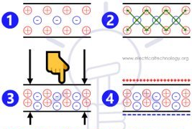
Technique
Working of piezo sensor
A sensor which works on the principle of Piezoelectricity is known as Piezoelectric Sensor.

Slide 39
Specification
●Maximum current 15mA;
●Voltage:≤30Vdc;
●Operating temperature:-20°C~+60°C
●Storage temperature:-30°C~+70°C
●Low Soldering temperature
●Strain sensitivity: 5V/µƐ
●Material: Quartz (mostly used)
Link for data sheet-
https://drive.google.com/file/d/14vjLFLfDX9N1wBRuEbYhlYJ7Q3bt68cu/view?usp=sharing

Slide 40
Schematic Diagram

Slide 41

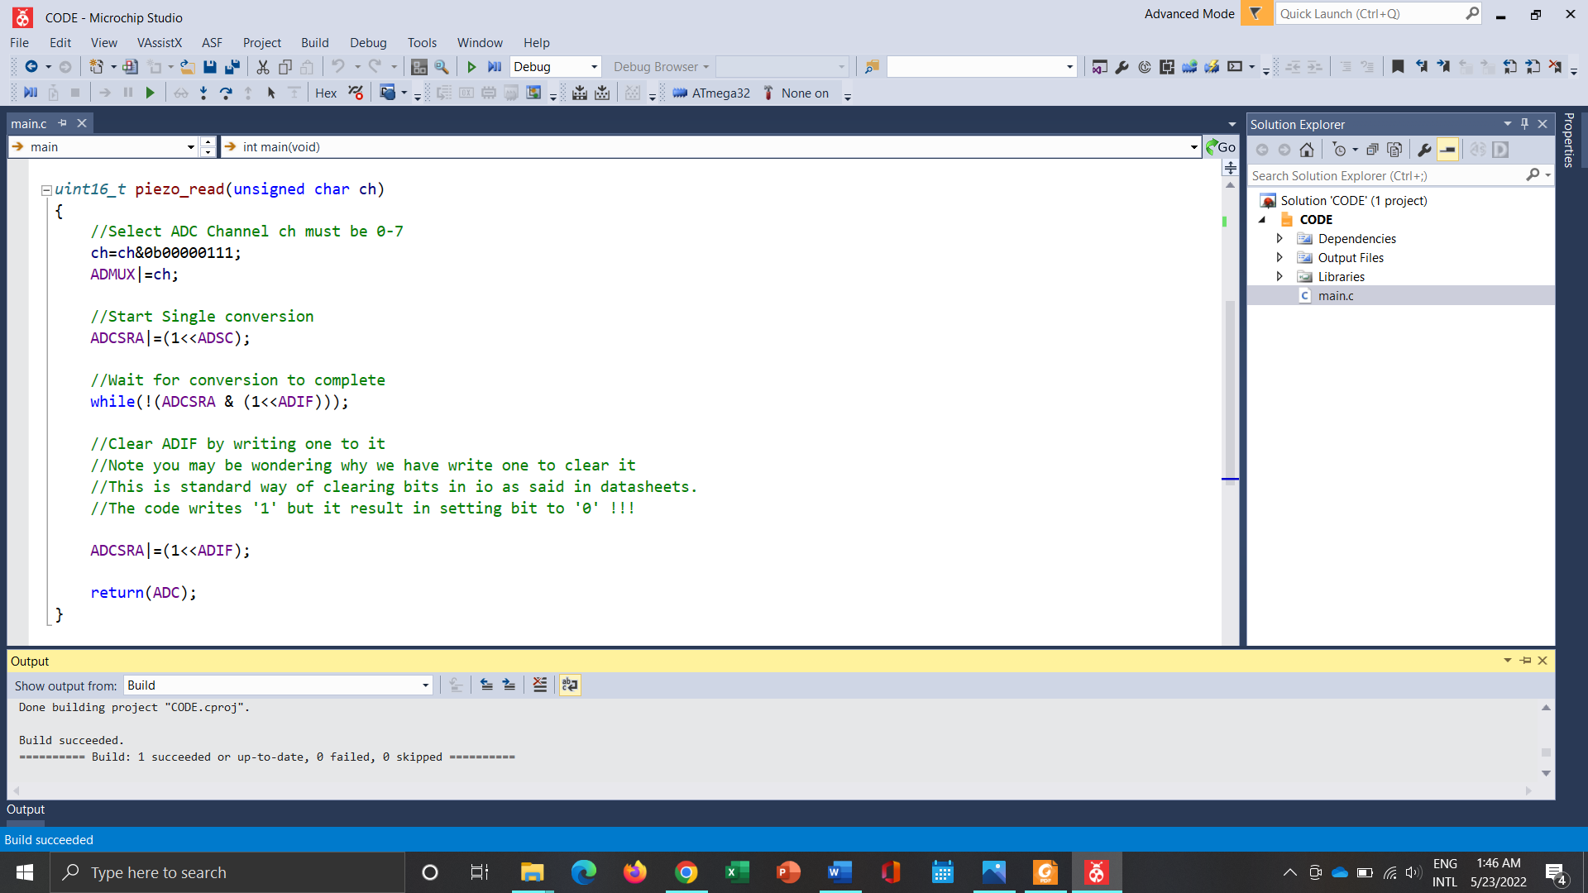

Piezo Sensor Code

Slide 42
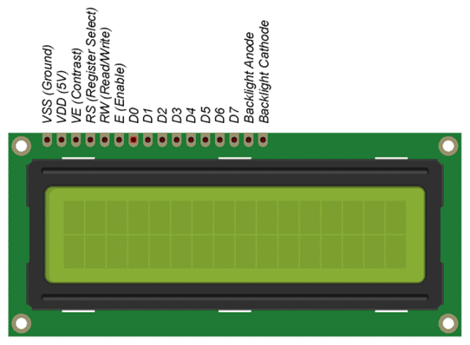
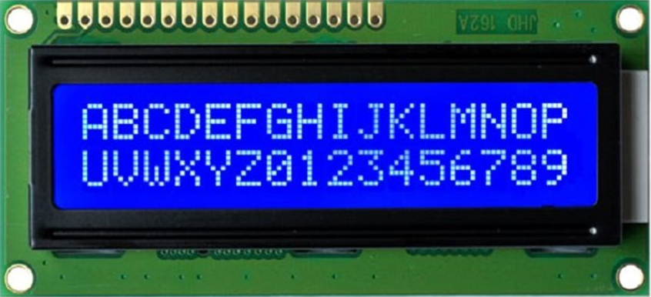
LCD Display
We use LCD display to show boxing techniques as well as relevant details of the punch and boxing player. Player can select any technique according to their desire. In our project, we use LCD display on 8-bit mode

Slide 43
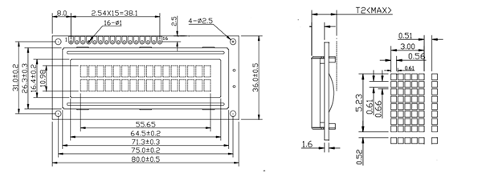
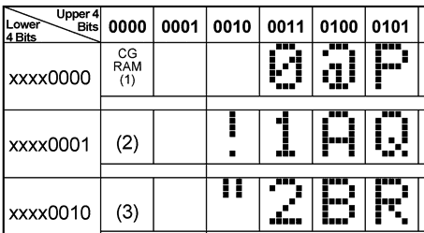
Internal Structure
16 columns and 2 rows.
Display 32 alphanumeric characters at a time.
Each character is shown in pixels in 5x8 dot format.
Two modes – command mode and data mode
Two different modes – 8 bit mode and 4 bit mode
Two operations -
1. Read-can write any text to lcd.
2. Write-can read data from lcd

Slide 44
Specification
Operating Voltage is 4.7V to 5.3V
Current range 1.5mA – 2.3mA
Alphanumeric LCD display module, meaning can display alphabets and numbers
Consists of two rows and each row can print 16 characters.
Each character is built by a 5×8 pixel box
Can work on both 8-bit and 4-bit mode
It can also display any custom generated characters
Available in Green and Blue Backlight
Link for data sheet-
https://drive.google.com/file/d/180FnRGq6rmBGp0QE8G3knLvxweZjrY5J/view?usp=sharing

Slide 45
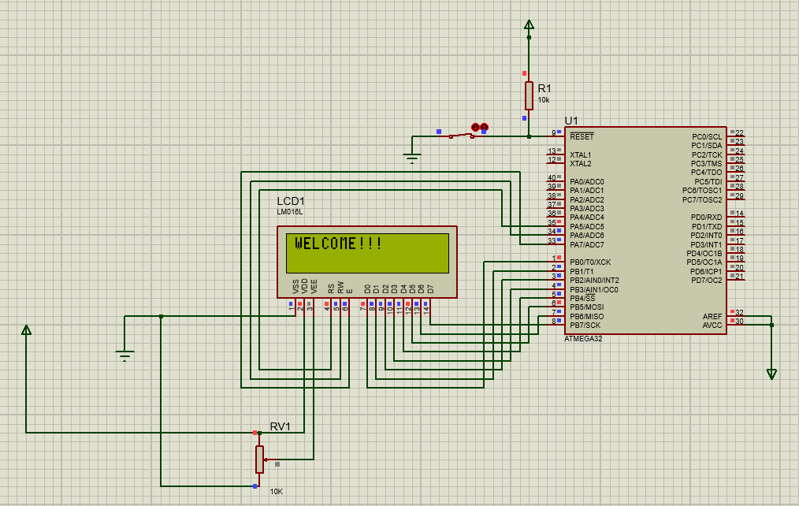
Schematic Diagram

Slide 46
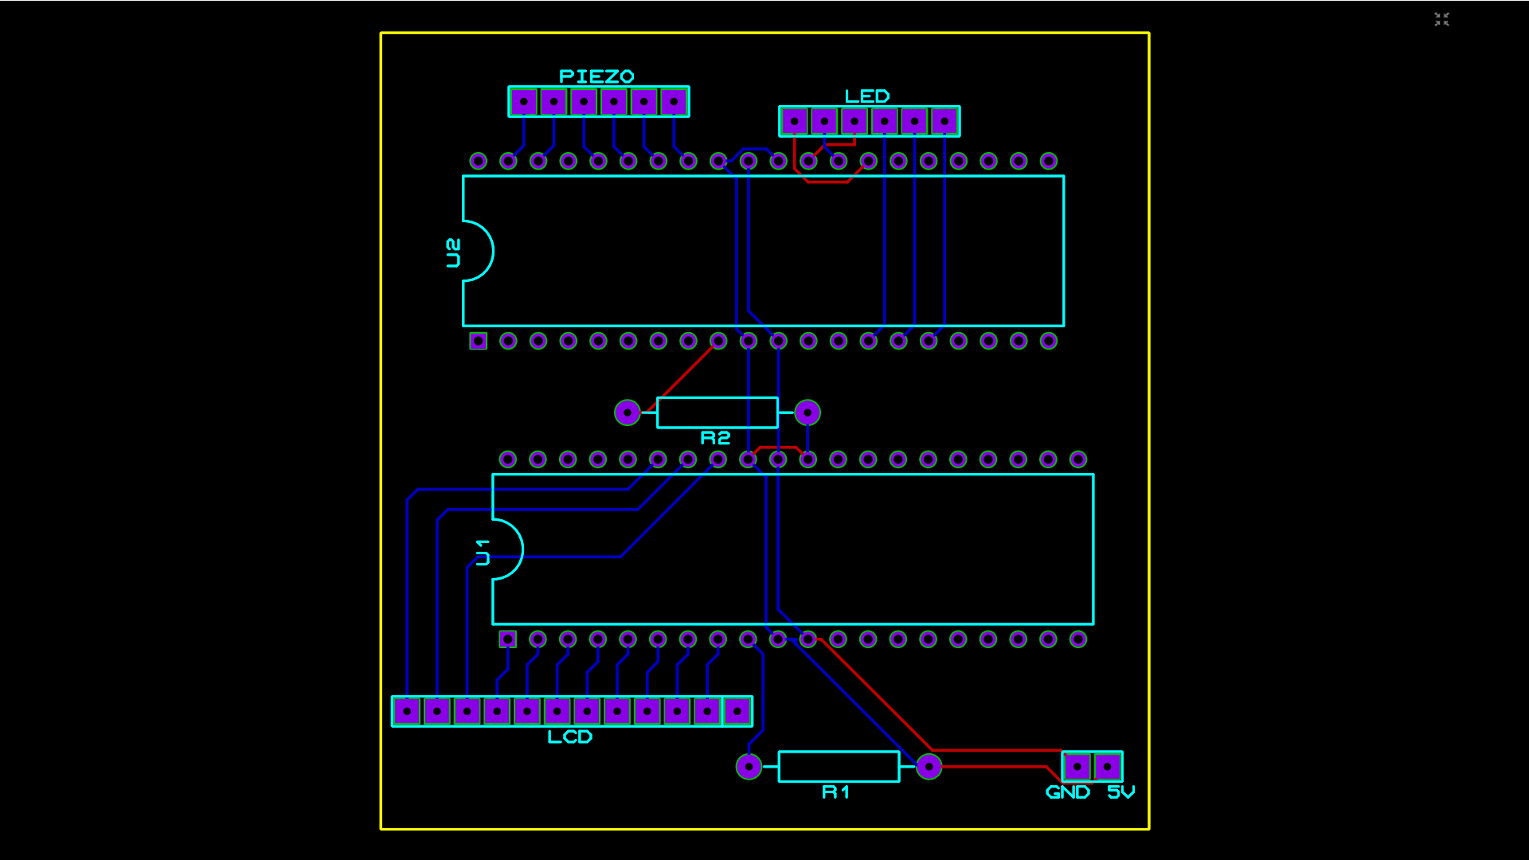
PCB Design - Piezo Sensors and LCD Display

Slide 47
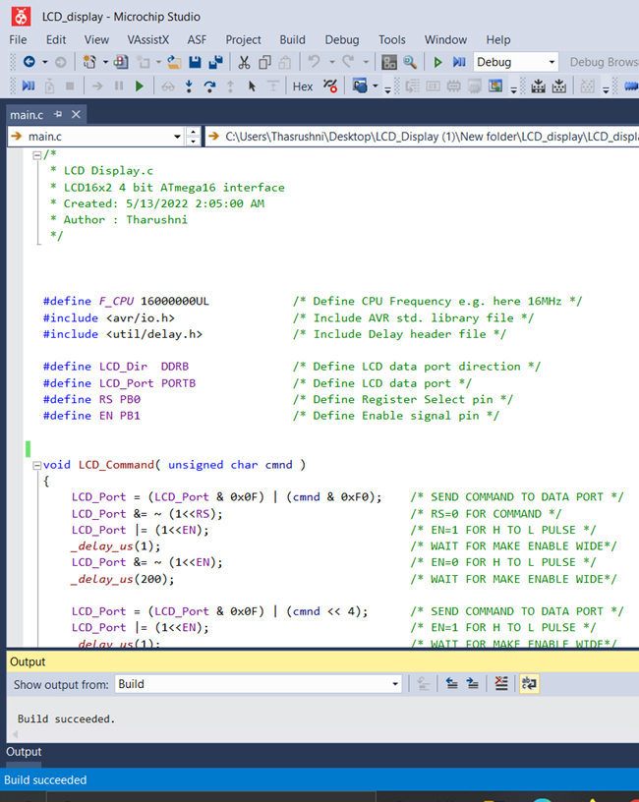
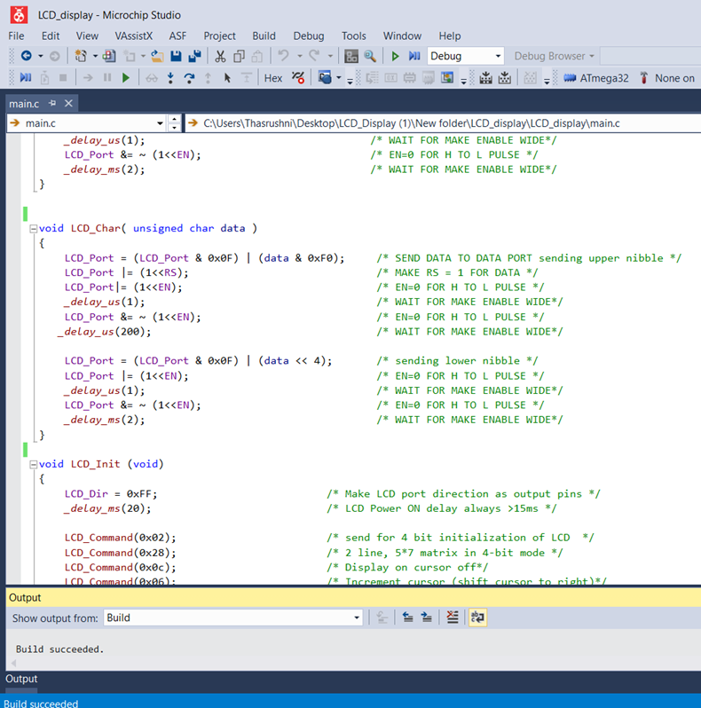
Code for LCD Display

Slide 48
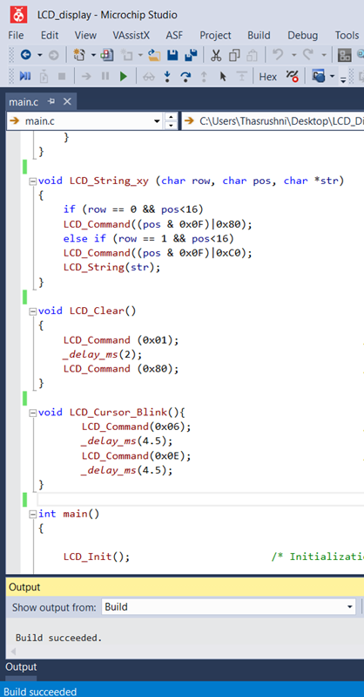
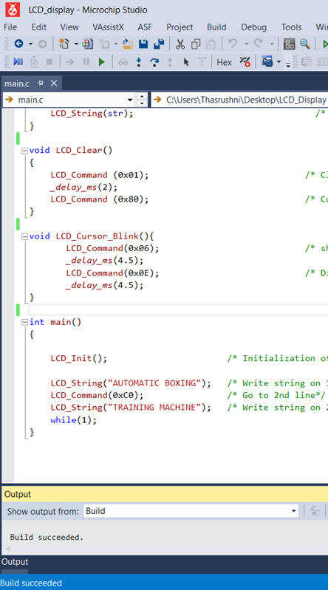


Slide 49
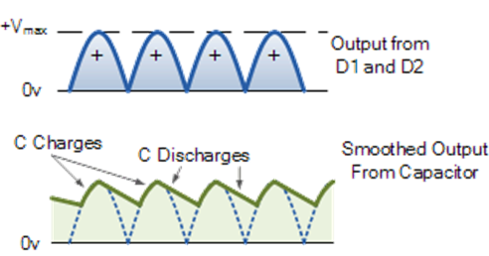
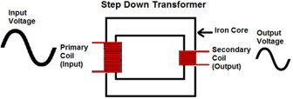
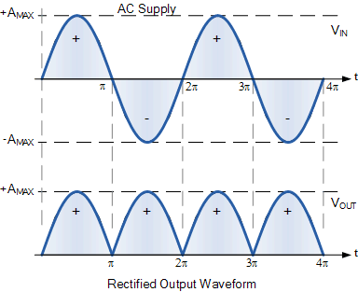
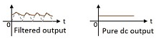
Power Supply
There are four main steps in creating 5V and 12V dual DC power supply from the 230V AC main supply.
1.Stepping down the Voltage Levels
Use step-down transformer to convert 230V AC power supply into 12V AC.
2.Rectifying the signal
12V AC current convert to DC current
3. Filter the signal
Capacitor is used to filter(smooth) the signal.
4.Regulating DC Voltage
A regulator IC is used for maintaining the constant DC output

Slide 50
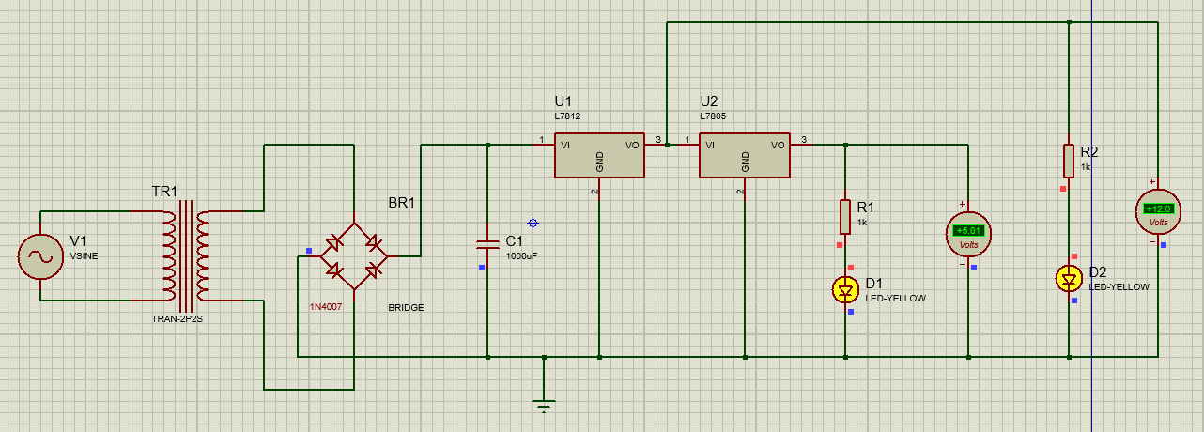
Schematic Diagram

Slide 51
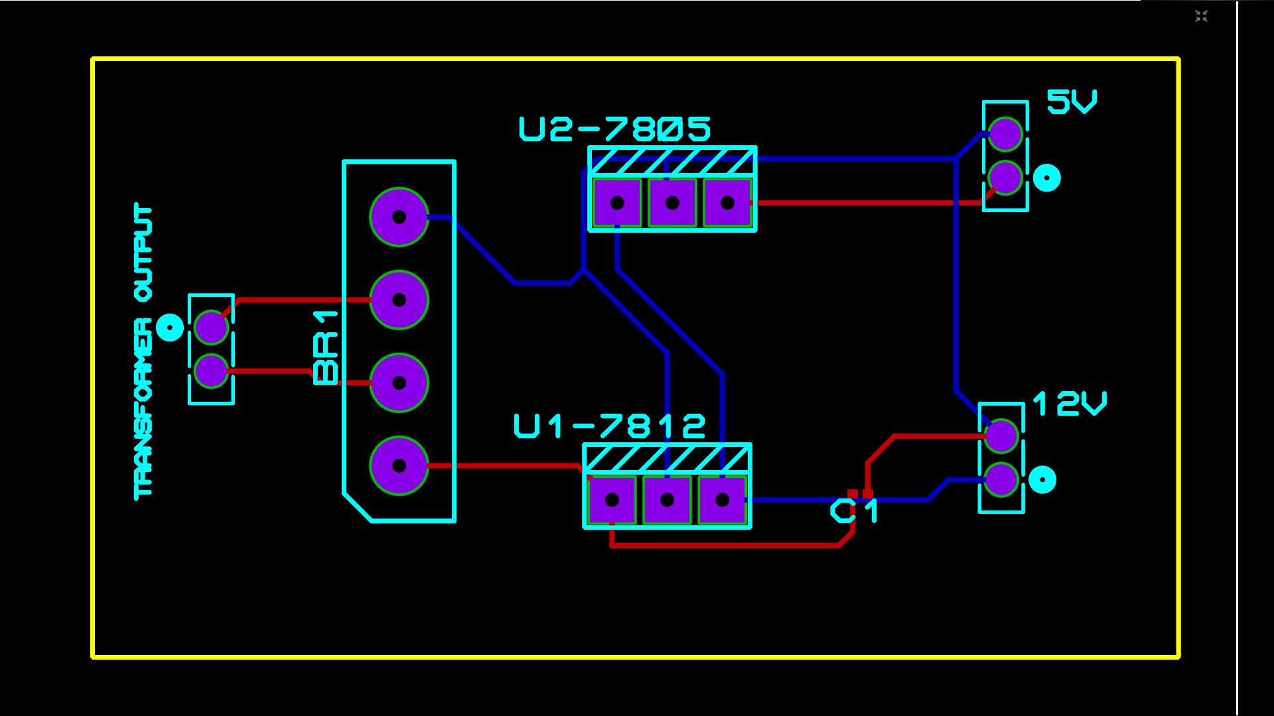
PCB Design

Slide 52
Member 2 - Kavishka T.A. (204101V)
Responsibilities :
4 Servo motors and programming.
Keypad and programming.
Programme fighting techniques.

Slide 53
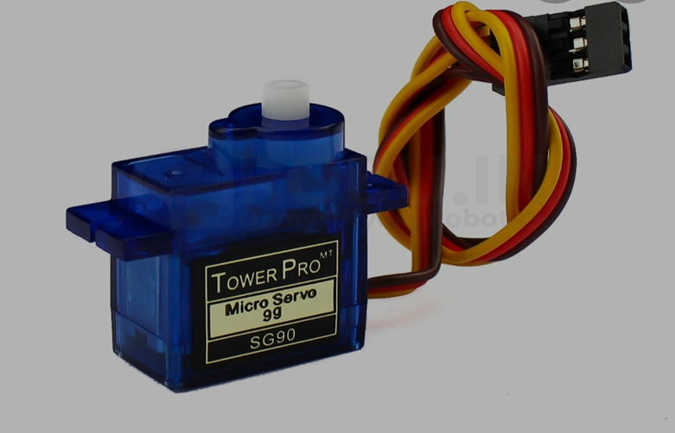
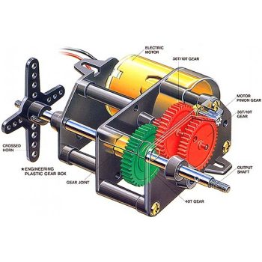

Servo Motor
Maximum voltage - 6V
Maximum current - 250mA
Link for datasheet: https://datasheetspdf.com/sg90

Slide 54
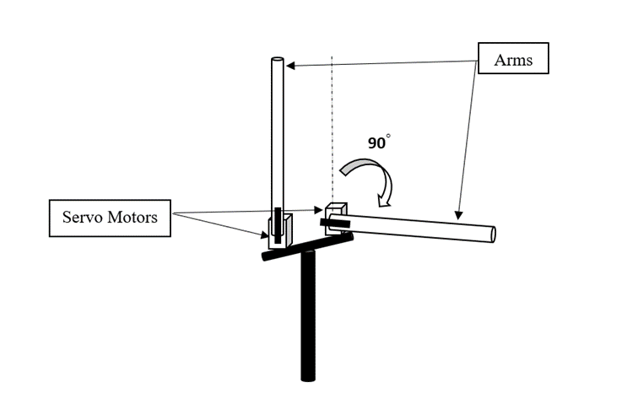

Motion Mechanism of Arms
The robot has 4 arms that move with the help of servo motors. These 4 arms can move in 90 degrees
These four arms act as the arms of the opposing player.
Servo Motors

Slide 55


4x4 Keypad
4x4 Keypad has 8 pins 4 pins for columns and 4 pins for rows.
Maximum Voltage - 35V DC
Maximum current - 100mA
Link for datasheet: https://robocombo.com/uploads/Dosyalar/4x3-matrix-membrane-tus-takimi-datasheet.pdf

Slide 56

Keypad internal view
Keypad use to input boxing techniques.
Keypad

Slide 57


Servo Motor Codes

Slide 58




Slide 59


Keypad Codes

Slide 60




Slide 61

Circuit Diagram

Slide 62

PCB Design

Slide 63
Member 3 - Nuska M.F.F. (204145H)
Responsibilities
Heartbeat sensor and programming
Bluetooth module and programming
Designing the Fitness Band

Slide 64


Fitness Band
A fitness band that consists of a heartbeat sensor is used to measure the heart rate of the player.
Bluetooth module is used to transfer the data from the sensor to the LCD display.
Bluetooth module in the fitness band transfer the heart rate of the player to the machine through serial communication

Slide 65

Heartbeat Sensor
Heart beat sensor
Maximum Current : 4mA
Maximum voltage : 5.5v
Model : SEN- 11574
Operating Temperature Range: -40°C to 85°C
Link for datasheet :
https://media.digikey.com/pdf/Data%20Sheets/Pulse%20Sensor%20PDFs/Pulse_Sensor.pdf

Slide 66
Technique
measure pulse waves by emitting red or infrared light from the body surface
detect the change in blood flow during heart beats as a change in the amount of light transmitted through the body.

Slide 67

Heartbeat sensor circuit diagram

Slide 68


Code for heartbeat sensor

Slide 69
Bluetooth Module
HC 05 Bluetooth is a wireless communication protocol; it is used in two devices as a sending and receiving the information.
Bluetooth is free to use in the wireless communication
Bluetooth operates at the frequency of the 2.41 GHz
HC-05 module has two modes :
1. Data mode: Exchange of data between devices.
2. Command mode: It uses AT commands which are used to change setting of HC-05. To send these commands to module serial (USART) port is used.

Slide 70
Technique
Bluetooth uses a technique known as frequency-hopping spread spectrum (FHSS), where the data is divided into chunks and transmitted via a carrier that hops from one random frequency to another.
Data is transmitted at a 1-Mbps rate using FSK.

Slide 71

HC 05 Bluetooth Module
Specifications:
Operating Voltage: 4V to 6V (Typically +5V)
Maximum Current: 40mA
Model: HC-05
Communication Method: Serial Communication
can switch between master mode and slave mode
Transmission Distance :10m
Link to data sheet :
https://components101.com/sites/default/files/component_datasheet/HC-05%20Datasheet.pdf

Slide 72


Pin description

Slide 73

Code for HC 05 Bluetooth module

Slide 74
Circuit diagram

Slide 75
Member 4- Siriwardena P.T.Y. (204203K)
Responsibilities:-
Design a mechanical system to move the machine
DC gear motor and programming
PIR sensor and programming

Slide 76




PIR Sensor

Slide 77





Maximum Voltage :- 20V
Maximum Current :-50uA
Sensing range :- 120 degree
Data Sheet :-https://www.mpja.com/download/31227sc.pdf
PIR

Slide 78



DC Motor
Maximum Voltage :- 15V
Maximum Current :- 1.2A
Stall torque:- 15N/cm @12V
Free-run speed:- 295 RPM @ 12V
DC Motor Data Sheet :- https://www.handsontec.com/dataspecs/motor_fan/JGB37-Geared%20Motor.pdf

Slide 79


Application
DC Motor and Wheel

Slide 80


Moving Process
Free area

Slide 81



Slide 82
Circuit Diagram

Slide 83
Member 5 - Ekanayaka Y.M. (204239B)
Stepper motor and programming.
Ultrasonic sensor and programming.
Design implementation of stepper motor and circuit diagram.
Integrate sub codes and implement final code.

Slide 84

Stepper Motor
Bipolar stepper motor has 5 pins one for input power and others for control the motor, through the driver.
Maximum current -:1.7A
Maximum Voltage-:12V
Lint for datasheet-:https://www.datasheet4u.com/datasheet-pdf/MotionKing/17HS4401/pdf.php?id=928661

Slide 85



Slide 86

Ultrasonic sensor
Maximum voltage-:5V
Maximum current-:15mA
Link for datasheet-:
https://datasheetspdf.com/pdf/1380136/ETC/HC-SR04/1

Slide 87


Slide 88


Height Adjustment
Detect the height of the player by signal difference of ultrasonic sensors.

Slide 89

Machine upper body
Screw thread and nut
This part is used to adjust the height of the machine according to the player’s height.
The cog which is in the stepper motor rotates according to the ultrasonic sensor detection. And the cog in the machine rotates according to the cog in the stepper motor and the screw in the bottom of the machine adjusts the height.
Cogs
Stepper motor

Slide 90
Circuit diagram

Slide 91







Codes for stepper motor and HC-SR04

Slide 92
References
https://www.electronicwings.com/avr-atmega/inside
https://microchip.lk/
https://tronic.lk/
https://blog.joinfightcamp.com/training/six-6-basic-boxing-punches/
https://www.self.com/gallery/basic-boxing-moves
https://www.coolthings.com/stryk-rxt-1-sparring-robot-boxing-trainer/
https://www.youtube.com/watch?v=6VBIuqjLBNU
https://www.youtube.com/watch?v=mKXLTchmay0
https://www.youtube.com/watch?v=jhcIjFgz2bI

Slide 93

Thank You!
Questions?

